Slide 1
300
A
200
B
C
100

Slide 2
Support acts like resistance
B
300
C
E
200
A
100
D

Slide 3
Resistance acts like support
D
300
A
200
C
E
100
B

Slide 4

Candlestick
Candle

Slide 5
Shadow
Body
Shadow

Slide 6
High
Close
Open
Low

Slide 7
Close
Open
Open
Close
Bullish
Candlestick
Bearish
Candlestick

Slide 8
DOJI

Slide 9
Bullish
Marubozu
Bearish
Marubozu

Slide 10
Hammer

Slide 11
Inverted Hammer

Slide 12
Book profit at resistance level
Support Level
Entry
Stop Loss

Slide 13
Hanging Man
Stop Loss
Confirmation Candle
Entry
Book profit at support level

Slide 14
Book profit at resistance level
Entry
Support Level
Confirmation
Candle
Stop Loss
Inverted
Hammer

Slide 15
Shooting Start
Stop Loss
Entry
Book profit at support level

Slide 16
B
Closes
Above
Candle A
A
Bullish
Engulfing
Pattern
Opens Gap Down

Slide 17
Entry
Stop Loss
Bullish Engulfing
Pattern

Slide 18
B
Opens Gap Up
A
Candle B engulfs A
Closes Below Candle A

Slide 19
Stop Loss
Entry
Bearish Engulfing
Pattern

Slide 20
A
B
Closes
Above Midpoint of
Candle A
Piercing Pattern
Opens Gap Down

Slide 21
Exit at next resistance level
Entry
Stop Loss
Piercing Pattern

Slide 22
Opens Gap Up
Closes
Below Midpoint of
Candle A
B
A
Dark Cloud Cover

Slide 23
Stop Loss
Entry
Book profit at next support level

Slide 24
A
C
B
Morning Star Pattern

Slide 25
Entry
A
C
B
Stop
Loss
Morning Star Pattern

Slide 26
B
A
C
Evening Star Pattern

Slide 27
Stop Loss
B
Entry
A
C
Evening Star Pattern

Slide 28
D
Head
Left
Shoulder
Right
Shoulder
B
F
G
Neckline
A
C
E
Head and Shoulder

Slide 29
D
Head
Stop Loss
G
Neckline
Entry
Target
Head and Shoulder

Slide 30
Inverted Head and Shoulder
C
E
G
Neckline
A
B
F
Left
Shoulder
Right
Shoulder
D
Head

Slide 31
Inverted Head and Shoulder
Target
Entry
C
E
G
Neckline
A
Stop Loss
B
F
D
Head

Slide 32
A
C
E
Neckline
B
D
F
Triple Top

Slide 33
A
C
E
Stop Loss
Neckline
B
D
F
Entry
Triple Top
Target

Slide 34
Triple Bottom
Target
F
Entry
Neckline
B
D
Stop Loss
A
C
E

Slide 35
A
C
E
Stop Loss
Support
B
D
Entry
Double Top
Target

Slide 36
Target
F
Entry
Resistance
B
D
Stop Loss
A
C
E
Double Bottom

Slide 37
Target
A
Resistance
C
D
Entry
F
Stop Loss
B
Cup & Handle Pattern
E

Slide 38
Target
Support
F
Entry
Symmetric
Triangle
Descending
Triangle
Stop Loss
Resistance
Ascending
Triangle
E

Slide 39
Target
A
C
Height of the triangle
E
Entry
F
Stop Loss
B
Symmetric
Triangle
E

Slide 40
Target
A
C
Height of the triangle
E
Entry
F
Stop Loss
D
B
Symmetric
Triangle
E

Slide 41
Target
A
C
E
Height of the triangle
Entry
D
F
Stop Loss
B
Ascending
Triangle
E

Slide 42
Target
Entry
A
C
E
Stop Loss
F
Height
of the triangle
D
B
E
Ascending
Triangle

Slide 43
Target
B
Height of the triangle
D
Entry
F
Stop Loss
A
C
E
Descending Triangle
E

Slide 44
Descending Triangle
B
Height
of the triangle
D
Stop Loss
F
A
C
E
Entry
Target
E

Slide 45
Descending Triangle
B
Height
of the triangle
D
Stop Loss
F
A
C
E
Entry
Target
E

Slide 46
Bullish Flags
F
Falling
Wedge
Rectangle
Pennant
E

Slide 47
Bearish Flags
Rising
Wedge
Rectangle
Pennant
F
E

Slide 48
Target 2
Target 1
B
Entry
Height of consolidation
Target 1
F
Total Height
of the Flag
Target 2
C
E
Rectangle
Flag
A

Slide 49
Target
F
Entry
Stop Loss
Mother
Bar
Inside Bars
E
Inside Bar Pattern

Slide 50
Target
Target
Entry
Entry
F
Stop Loss
Stop Loss
Mother
Bar
E
Inside Bar Pattern

Slide 51
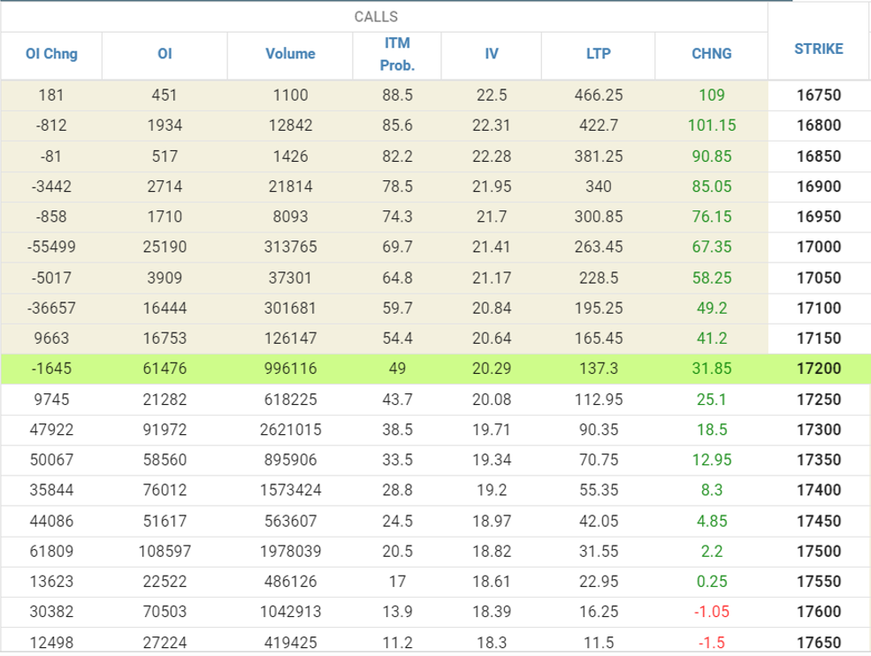
CE
Target
ITM
F
Entry
ATM
Stop Loss
OTM
E

Slide 52
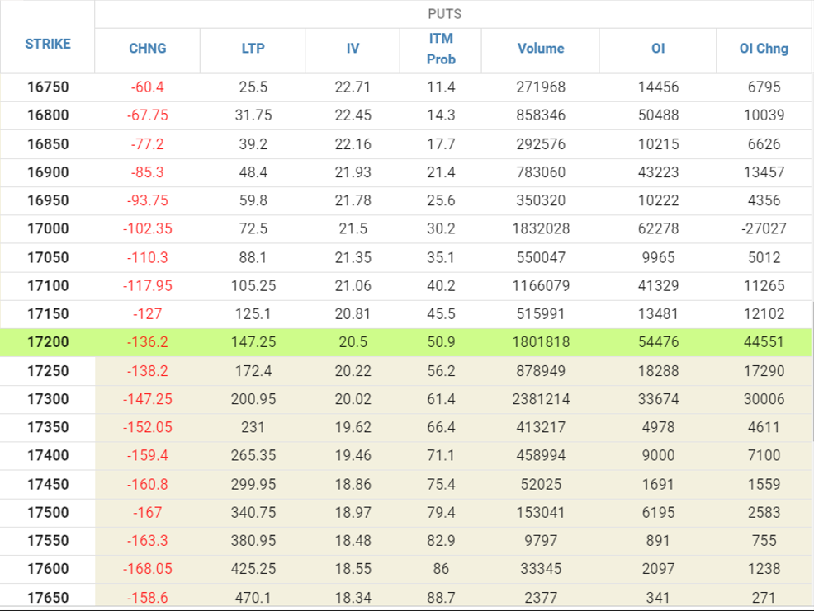
PE
Target
OTM
F
Entry
ATM
Stop Loss
ITM
E

Slide 53
50
Target
Profit
F
Entry
Break Even
Stop Loss
Loss
0
50
Asset Price
E

Slide 54
50
Target
Profit
F
Entry
Break Even
Stop Loss
Loss
0
50
Asset Price
E

Slide 55
50
Target
Profit
F
Entry
Break Even
Stop Loss
Loss
0
50
Asset Price
E

Slide 56
50
Target
Profit
F
Entry
Break Even
Stop Loss
Loss
0
50
Asset Price
E

Slide 57
50
Target
Profit
F
Entry
Break Even
Stop Loss
Loss
0
50
Asset Price
E

Slide 58
50
Target
Profit
F
Entry
Break Even
Stop Loss
Loss
0
50
Asset Price
E

Slide 59
50
Target
Profit
F
Entry
Break Even
Stop Loss
Loss
0
50
Asset Price
E

Slide 60
50
Target
Profit
F
Entry
Break Even
Stop Loss
Loss
0
50
Asset Price
E

Slide 61
50
Target
Profit
F
Entry
Break Even
Stop Loss
Loss
0
50
Asset Price
E

Slide 62
50
Target
Profit
F
Entry
Break Even
Stop Loss
Loss
0
50
Asset Price
E

Slide 63
50
Target
Profit
F
Entry
Break Even
Stop Loss
Loss
0
50
Asset Price
E

Slide 64
50
Target
Profit
F
Entry
Break Even
Stop Loss
Loss
0
50
Asset Price
E

Slide 65
50
Target
Profit
F
Entry
Break Even
Stop Loss
Loss
0
50
Asset Price
E

Slide 66


Slide 68


Slide 69


Slide 70

“
I will tell you how to become rich.
Close the doors.
Be fearful when others are greedy.
Be greedy when others are fearful.
”
Warren Buffett

Slide 71

“
Rule 1 : Never Lose Money.
Rule 2 : Never Forget Rule No. 1
”
Warren Buffett

